Slide 1
Bank Marketing Prediction
Build a predictive model to predict whether a bank customer will subscribe to a term deposit or not

Slide 2
Outlines:
Data description ( Introducing the dataset)
Cleaning process
Model building

Slide 3
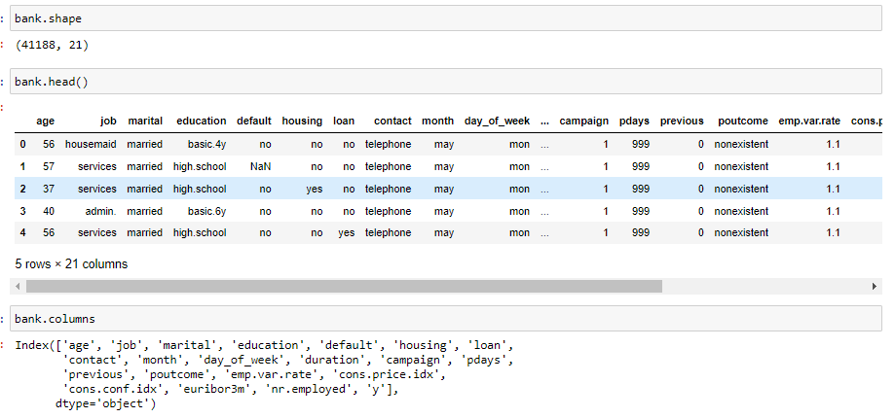
Data description

Slide 4
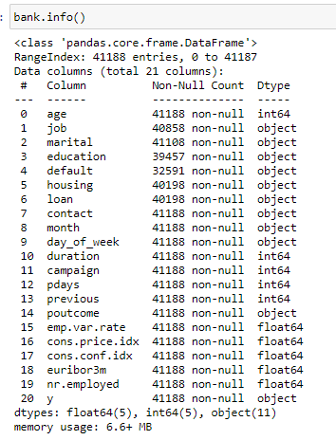

Slide 5
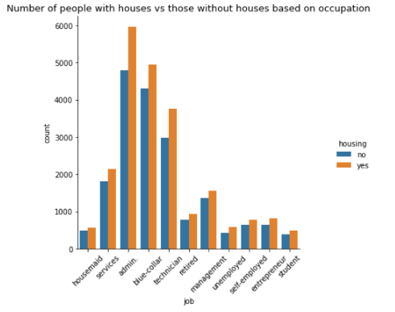
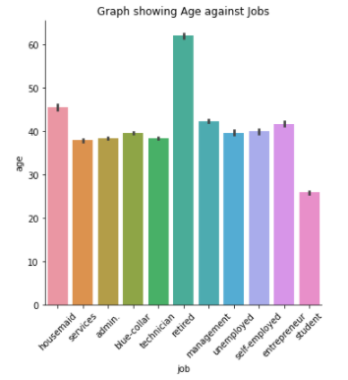
Features

Slide 6
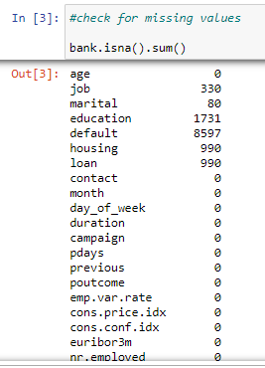
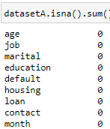
Missing data
How I dealt with the missing data:
A look at the dataset gave me an hint on how to deal with each columns, and the method I used basically is set fixed value for all the columns with missing data based on their most occurring value

Slide 7
Steps taken
Encoding
Splitting
Scaling
Model

Slide 8
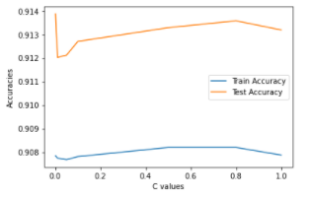
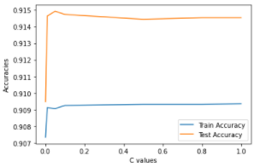
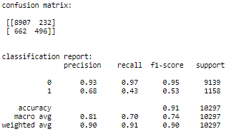
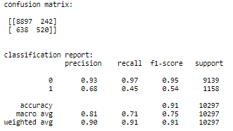
Unscaled data vs Scaled data

Slide 9
Dealing with the imbalance data
Methods used to handle imbalance data:
1. Under sampling the majority class
2. Over sampling the minority class ...
3. Over sampling the minority using SMOTE

Slide 10
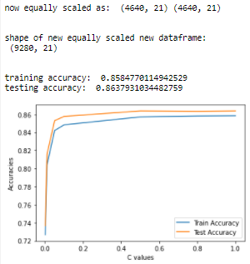
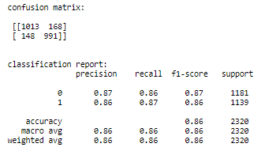
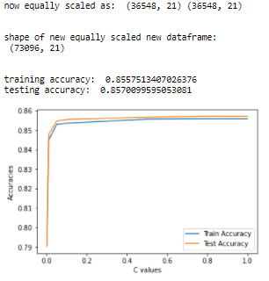
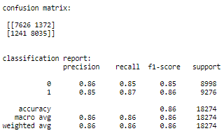
Under sampling the majority class vs
Over sampling the minority class

Slide 11
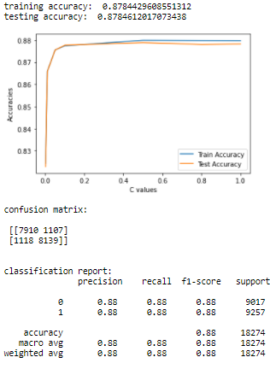
3. Over sampling the minority using SMOTE
Observe I changed the value of my C_value of my logistic regression go give a test accuracy greater than training accuracy.
SMOTE DID BEST SO-FAR

Slide 12
THANK YOU
Data source: Aileadtech

